Slide 1
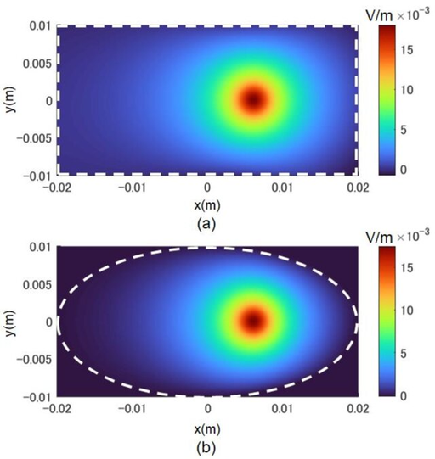
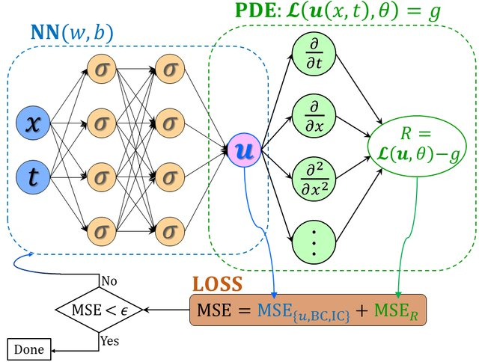


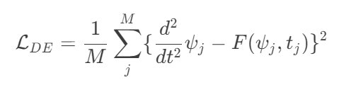
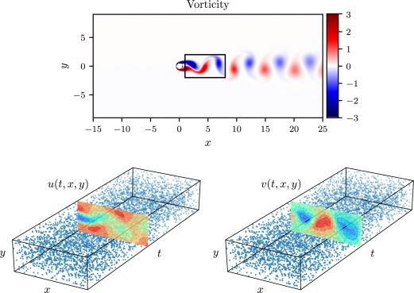

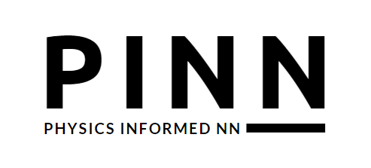

Rayo de particulas [4]
img Arquitectura [1]
img Navier Stokes [3]

Slide 2
[1] Meng, Xuhui & Li, Zhen & Zhang, Dongkun & Karniadakis, George. (2019). PPINN: Parareal Physics-Informed Neural Network for time-dependent PDEs.
[2] Robert K.Y. Li, Lee, E., & Luo, T. (2021). Physics-informed neural networks for solving multiscale mode-resolved phonon Boltzmann transport equation. 19, 100429–100429. https://doi.org/10.1016/j.mtphys.2021.100429
[3] Maziar Raissi, Perdikaris, P., & George Em Karniadakis. (2019). Physics-informed neural networks: A deep learning framework for solving forward and inverse problems involving nonlinear partial differential equations. 378, 686–707. https://doi.org/10.1016/j.jcp.2018.10.045
[4] Fujita, Kazuhiro. (2021). Physics-Informed Neural Network Method for Space Charge Effect in Particle Accelerators. IEEE Access. 9. 164017-164025. 10.1109/ACCESS.2021.3132942.
[5] Francisco Sahli Costabal, Yang, Y.-B., Perdikaris, P., Hurtado, D. E., & Kuhl, E. (2020). Physics-Informed Neural Networks for Cardiac Activation Mapping. 8. https://doi.org/10.3389/fphy.2020.00042
[6] Cuomo, S., Schiano, V., Giampaolo, F., Gianluigi Rozza, Maziar Raissi, & Piccialli, F. (2022). Scientific Machine Learning Through Physics–Informed Neural Networks: Where we are and What’s Next. 92(3). https://doi.org/10.1007/s10915-022-01939-z
‌
‌
‌

